Slide 1
Designing Intelligent Agents (COMP4105) : Presentation Therapize Divyansh Oze
© University of Nottingham (2022)
Notes:
Hey Everyone,
So I worked on a project to develop Therapy Chatbots that I named as 'Therapize'

Slide 2
Outline
Experiments
Hyper-parameter tuning
Special cases
Results
Tuning results
Text responses
Project Introduction​
Background​
Aim​
Related Work
Eliza
Parry
Cleverbot
Approaches Used for Therapize
Bag of Words
GPT2 Fine-Tuning​
Workflows for Agent
Bag of Words Model
GPT2 Model
Learnings and Conclusions​
Future Prospects​
References​
Notes:
The general outline for how the presentation is designed.

Slide 3
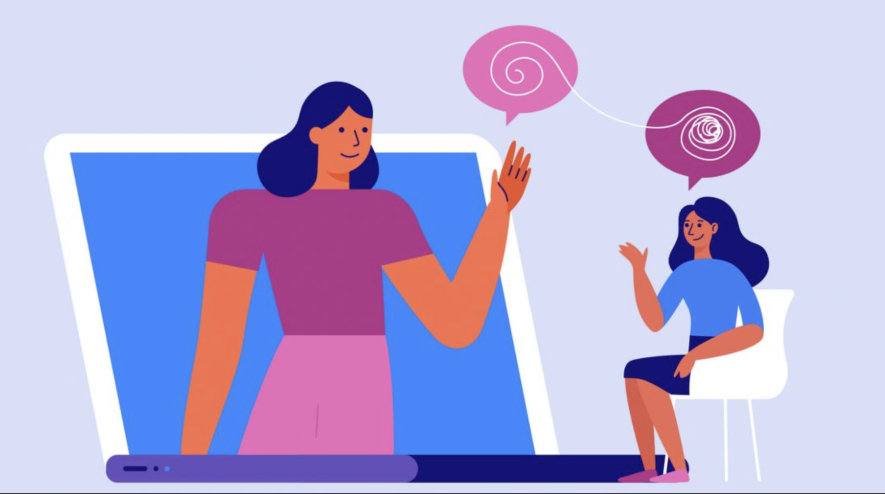
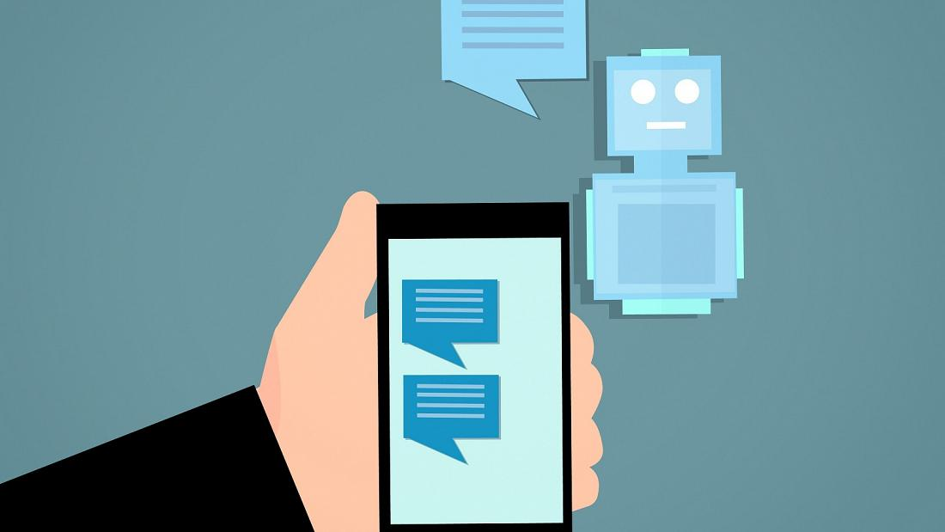
Therapize
Why Therapy:
Why Chatbot for seeking Therapy:​
Ease of Use​
Time-Effective service​
Proactive client interaction​
​
Figure [1] : Graphical image for decluttering of thoughts [https://milehighpsychiatry.com/4-reasons-why-therapy-is-beneficial/]
Figure [2] : Why Chatbot for Therapy [https://www.euronews.com/next/2021/07/21/humans-aren-t-quite-ready-for-a-chatbot-takeover-says-gottingen-university-study]
Notes:
Now, let's start with the Introduction that led to this project.
Introduction that led to this project:
Given the hardships in life, whether it’s the philosophical existential dreads, deep attachment to social media platforms for dopamine intake, or the external cruelty within society and people. There has been a rising need for mental health support for everyone. It let’s you be more aware of the powerhouse we have up here, get in a sense of controlling it by understanding more of it; interacting with people to allign our thoughts well.
Other than having a humanitarian and personal inclination towards helping people understand and be aware of mental awareness, the project aimed at creating a therapeutic-intelligent agent.
Why Chatbot for seeking Therapy:
Although there is a good supply of qualified professionals out there to provide help and guidance, there is an agonizing wait for the patients to get an appointment. The idea of having a conversational chatbot helps ease the pain and presents a low-barrier way to reach out for what can be an intimidating and even life-threatening problem in life.
-Ease of use
-Time-effective service
-Proactive client interaction

Slide 4
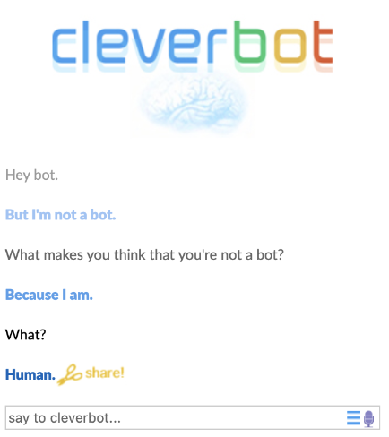
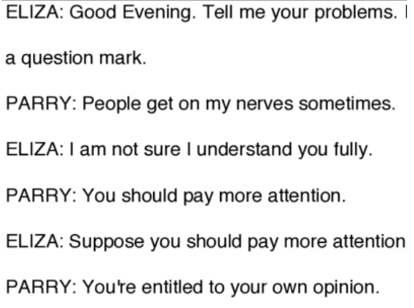
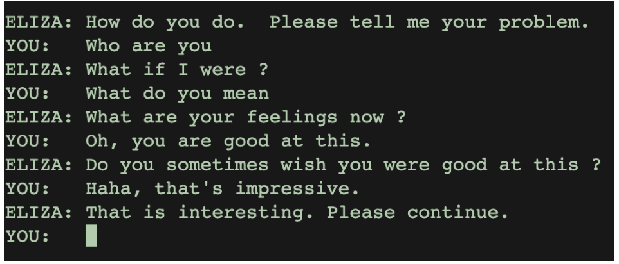
Related Work
Eliza (1964-1966)
First Chatbot
Mimic a Psychologist
Simulation of Intelligence
Parry (1974)​
Mimic a paranoid individual​
Special Turing Test​
Colby's Belief​
Cleverbot (1997)
Hand-Coded
Rule-Based
Figure [3] : My conversation with Eliza
Figure [4] : Eliza meets her nemesis Parry
Figure [5] : My conversation with cleverbot
Notes:
Now we are looking at some chatbots created in the past of the similar domain:
Eliza: Goal to mimic a psychologist using a fundamentally easy trick. It was more psychological instead of using fancy algorithms to implement it.
Flipping the sentence around to ask a digging question to make the vulnerable person fall prey.
Parry:
On the other hand, designed to mimic a paranoid individual, belief and thought process. All sorts of insecurities, paranoia one could imagine for an individual to have, parry was mimicking that kind.
Turing test to judge parry>> capability to mimic human behaviour.
Colby believed that using an IA >> much better to study any disease than having a patient.
Cleverbot:
Several hand-coded and rule-based chatbots launched using the primary dialogue intelligent agent; had a set of hand-written rules to generate replies.
Impressive performance; not if tested rigorously; would seem like an expert bot.
Following are my conversations with Eliza and Cleverbot; standing true to their nature of programming.

Slide 5
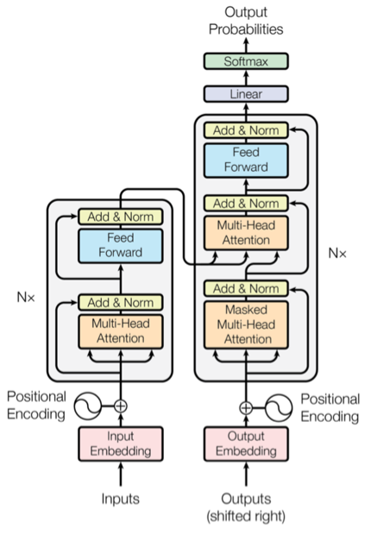
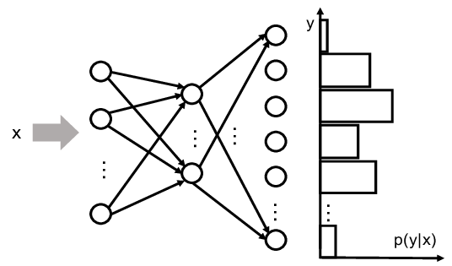
Approaches Used for Therapize
Bag of Words:
GPT2 Fine-Tuning:​
Figure [6] : Architecture of ANN with Softmax Output layer
Figure [7] : Architecture of Transformers
Notes:
Different Datasets for both tasks. Intents fille for Bag of words with my own tags, responses, inputs.
Dataset for GPT, a json file with communication between a web user and multiple certified mental health professionals.
Approaches:
Environment: the space where the user and chatbot are interacting.
Agents: The bot// how it’s taking the text, how it’s responding to the text
Bag of Words:
Bag of words used a basic ANN with one hidden layer and softmax at the O/P
To give out a probability distribution. GPT2: Generative Pre-trained Transformers.
Not gonna go into depth:
Positional Encoding: that aims to modify the represented meaning of a specific word depending on its position in the sequence. ///
Transformer:
makes use of multiple attention layers to predict the next token for a sequence.
The multiple attention layers help get the global dependencies for input processing. // intra/inter attention for context.
Why we go for Transformers and not LSTM/RNNs
It can hold the contextual knowledge for long sequences without falling prey to the vanishing gradient descent problem.

Slide 6
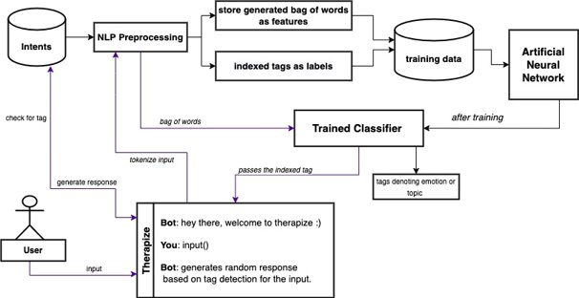
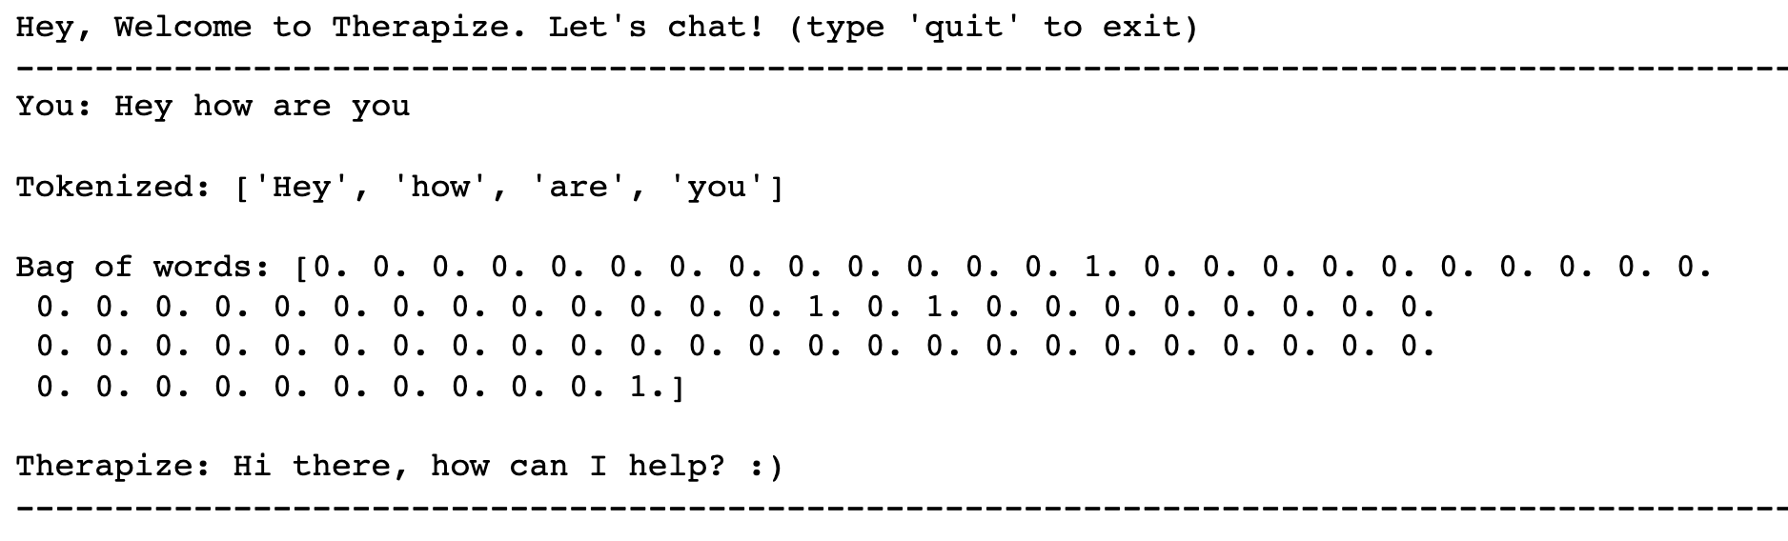
Workflow: Bag of Words Approach
We have combined the preprocessing with feature extraction in the NLP preprocessing block as follows:
Bag of words as features:
generated from the preprocessing block to be later stored as features for the training phase, to predict indexes for tags denoting emotions or topics.
Indexes for tags as labels:
we proceed to put indexes of the tags present in the intents file to store as labels for the model.
Figure [8]: Workflow for Bag of Words Approach
Figure [9]: User Input to Response Generation
Notes:
Looking from the Agent POV and user interaction with the trained Therapize.
1) user sends input
2) input is sent to NLP preprocessing for tokenization; brought into the right format before bag of words generation.
3) bag of words sent to trained classifier for indexes to tags
4) tags to be checked with intents for responses; if match; then generate response under that particular tag.

Slide 7
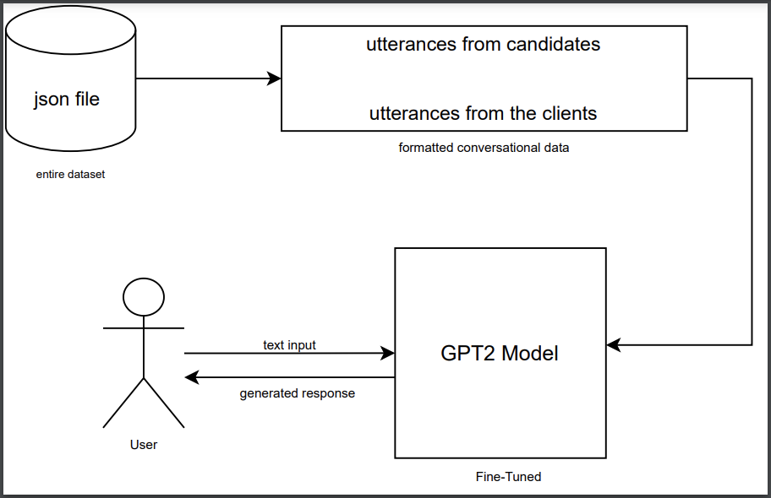
Workflow-2
GPT2 Fine-Tuning
Figure [10] : Workflow for the GPT2 Fine-Tuned Model
Notes:
General workflow for how I designed the GPT2 Fine-tuning model.
Data was formatted from the JSON file consisting of user information/question and clients info/answers.
JSON to Dataframe. //Conversational format.

Slide 8

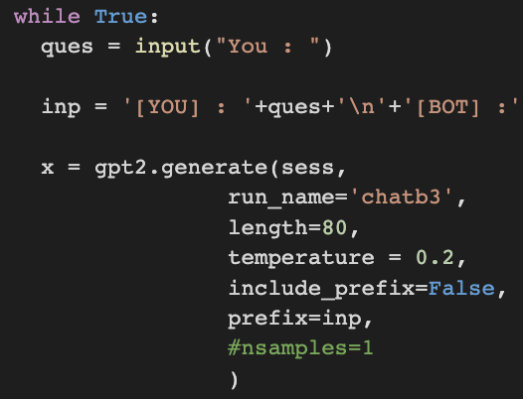
Experiments
Parameter Tuning
Bag of Words: epochs, lR, probability score.
GPT2 Fine-Tuning: epochs, temperature.
Special Cases
Checking misspells.
Checking to combine multiple emotions or responses for multiple tags.
Figure[11] : Probability score
Figure[12] : Temperature parameter
Notes:
Onto the parameter tuning, the usual testing was with checking number of epochs, what LR suits the best.
In the bag of words, probability score was another parameter that we could use to play in generating responses as shown here.
GPT: temperature parameter // controls how on and off topic the model goes with the value for parameter.

Slide 9
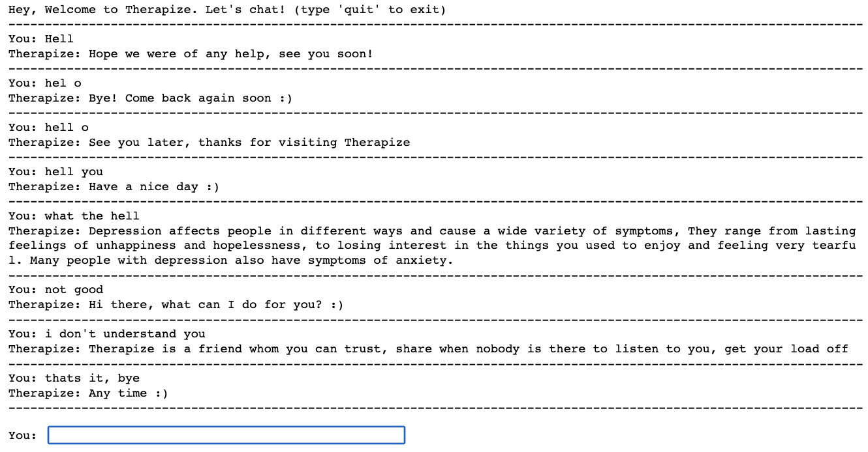
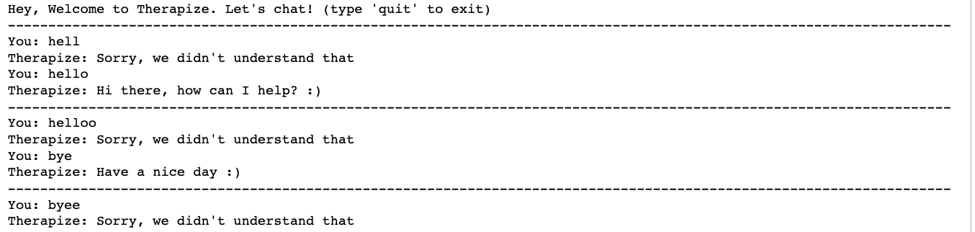
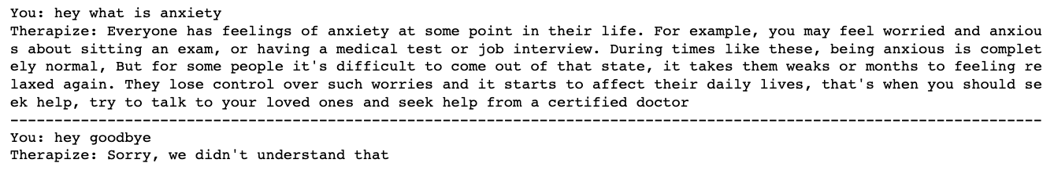
Results: Bag of Words
Lr and Epoch:
Responses generated from special cases:
Low prob score conversation
lr | epochs | loss
0.001 | 150 | 0.119
0.001 | 250 | 0.022
0.001 | 500 | 0.001
0.01 | 150 | 0.0003
0.01 | 250 | 0.0001
0.01 | 500 | 0.0001
Figure[13] : Responses generated for misspelt inputs
Figure[14] : Responses generated setting probability score as low
Figure[15] : Combining responses from two tags
Notes:
LR and epoch:
With results, it was found that 0.01 proved to be the right value for LR as it barely needed 150 epochs to be trained. // Large batch-size// Could've been much less.
Overfitting after that// not generalizing well to the new inputs.

Slide 10
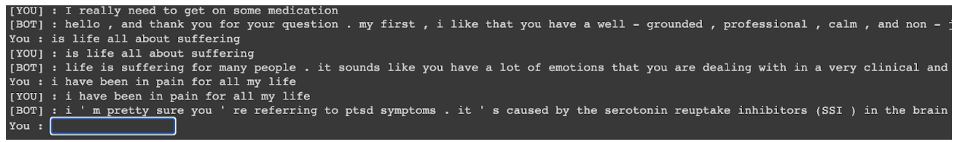
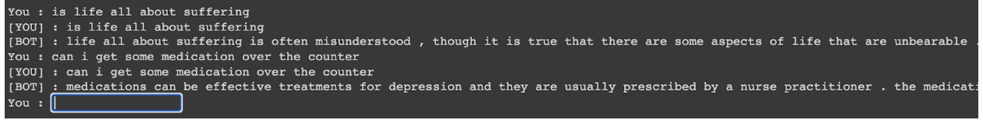
Results: GPT2 Fine-Tuning
Epochs responses:
Temperature change responses
epochs | loss
500 | 1.96
1000 | 0.46
15000 | 0.13
Figure[16] : Responses generated for low temperaturre
Figure[17] : Responses generated for high temperature
Notes:
Epochs and loss:
The model clearly showed improvement with more steps involved to train generating the responses.
Low temperature:
Doesn't generalize well, sticks to the information and doesn't go off topic.
High Temperature:
Generalizes well; Tries to go broader and generates some esoteric answers.

Slide 11
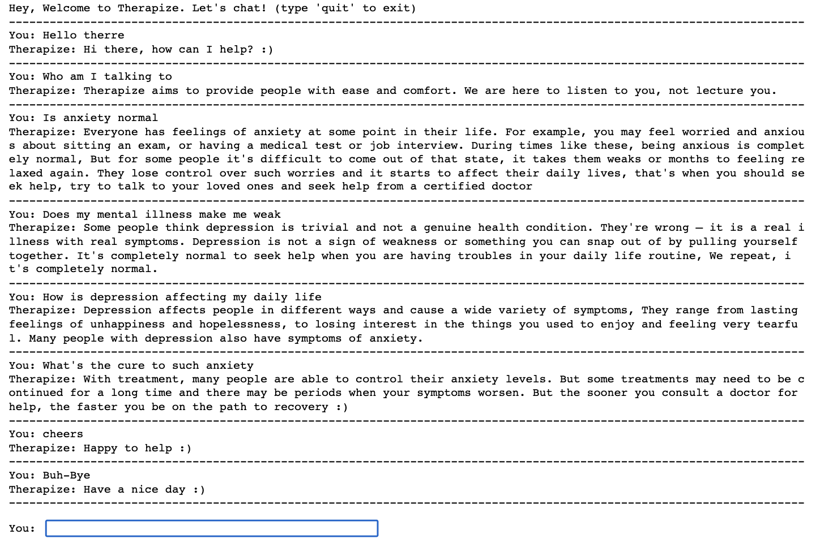
Conversation Snippets
Bag of words :
Figure[18] : A conversation between User and Therapize
Notes:
Bag of words and GPT model comparison.
Bag of words training extremely well on just ‘whatever’ epochs and overfitting after a point since the json file is a little too small.
GPT model showing changes in responses to training on 500-1000-1500 epochs.
GPT model being able to generate some esoteric answers as well.
Based on the temperature change, exploitation and exploration analogy comparison.
Fine-tuning of GPT and not zero-shot learning

Slide 12
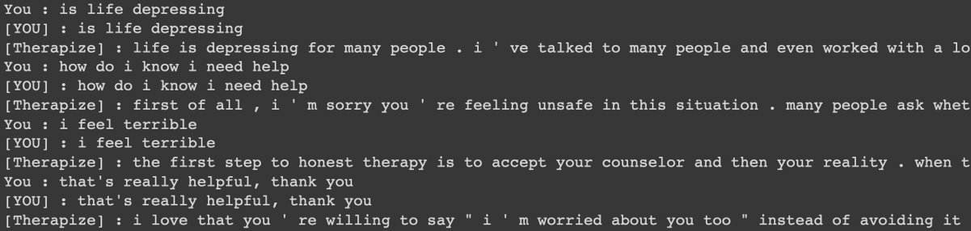
Learnings and Conclusions
Overall, the bag of words approach for chatbots develops an agent capable of generating decent responses. However, the model cannot give unexpected esoteric answers with a broader view if such patterns are not fixed in the intents mentioned.
NLP is the backbone for developing such conversational chatbots. Better pre-processing and cleaning yields better results for special cases.
GPT model able to handle some philosophical conversations with the users, worked incredibly well.
Important to Note: Fine-tuning of GPT and not Zero-Shot learning​.
Figure[19]: Conversation snippet from GPT2 interacting with User
Notes:
Bag of words and GPT model comparison.
Bag of words training extremely well on just ‘whatever’ epochs and overfitting after a point since the json file is a little too small.
GPT model showing changes in responses to training on 500-1000-1500 epochs.
GPT model being able to generate some esoteric answers as well.
Based on the temperature change, exploitation and exploration analogy comparison.
Fine-tuning of GPT and not zero-shot learning

Slide 13
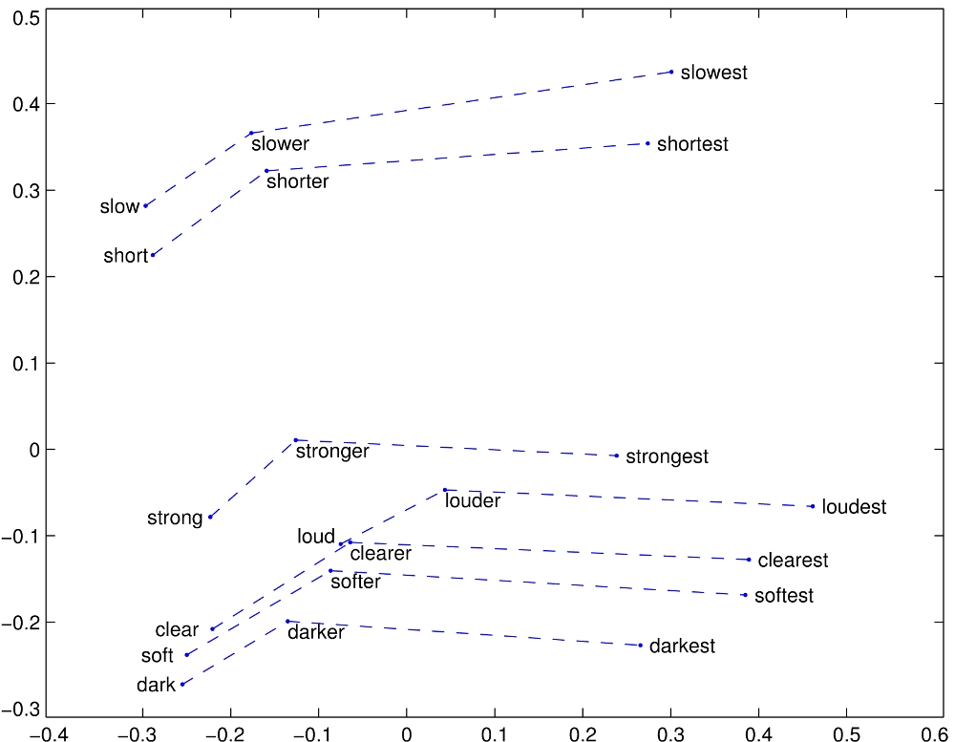
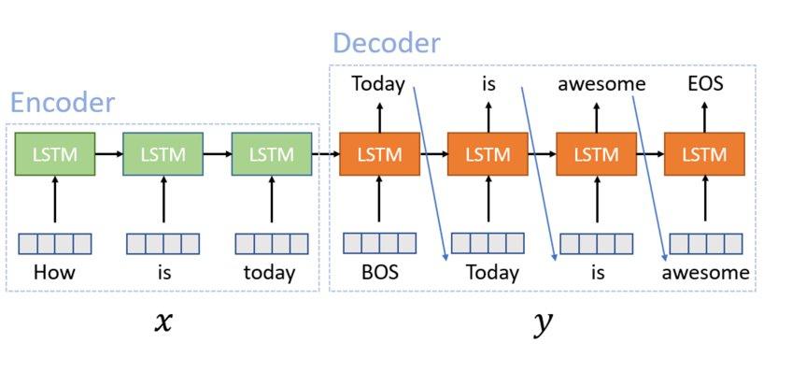
Future Prospects
Personalities and other information about the user if securely accessed, can be used to generate unique answers for individuals that would have greater impact on them.
Link the therapy bot to some qualified mental health practitioner available nearby to the user, at the user’s permission, to help in any case of emergencies
GloVe or Word2Vec word embeddings
Seq2Seq Model using LSTMs
Figure [20] : GloVe word embeddings
Figure [21] : Seq2Seq Model using LSTMs
Notes:
Didn't make use of personality column with the GPT2 model that had all details for users as well.
GloVe: unsupervised approach to represent words in a vector latent space; words with similar meaning tied together as shown in figure. [also perform arthirmetic operatitons]

Slide 14
References
ELIZA—a computer program for the study of natural language communication between man and machine [https://dl.acm.org/doi/10.1145/365153.365168]
Ten criticisms of parry [https://dl.acm.org/doi/10.1145/1045200.1045202]
Chatbots and Conversational Agents in Mental Health: A Review of the Psychiatric Landscape [https://pubmed.ncbi.nlm.nih.gov/30897957/]
GloVe: Global Vectors for Word Representation [https://nlp.stanford.edu/projects/glove/]
Investigation of Sentiment Controllable Chatbot [https://arxiv.org/pdf/2007.07196.pdf]

